Slide 1
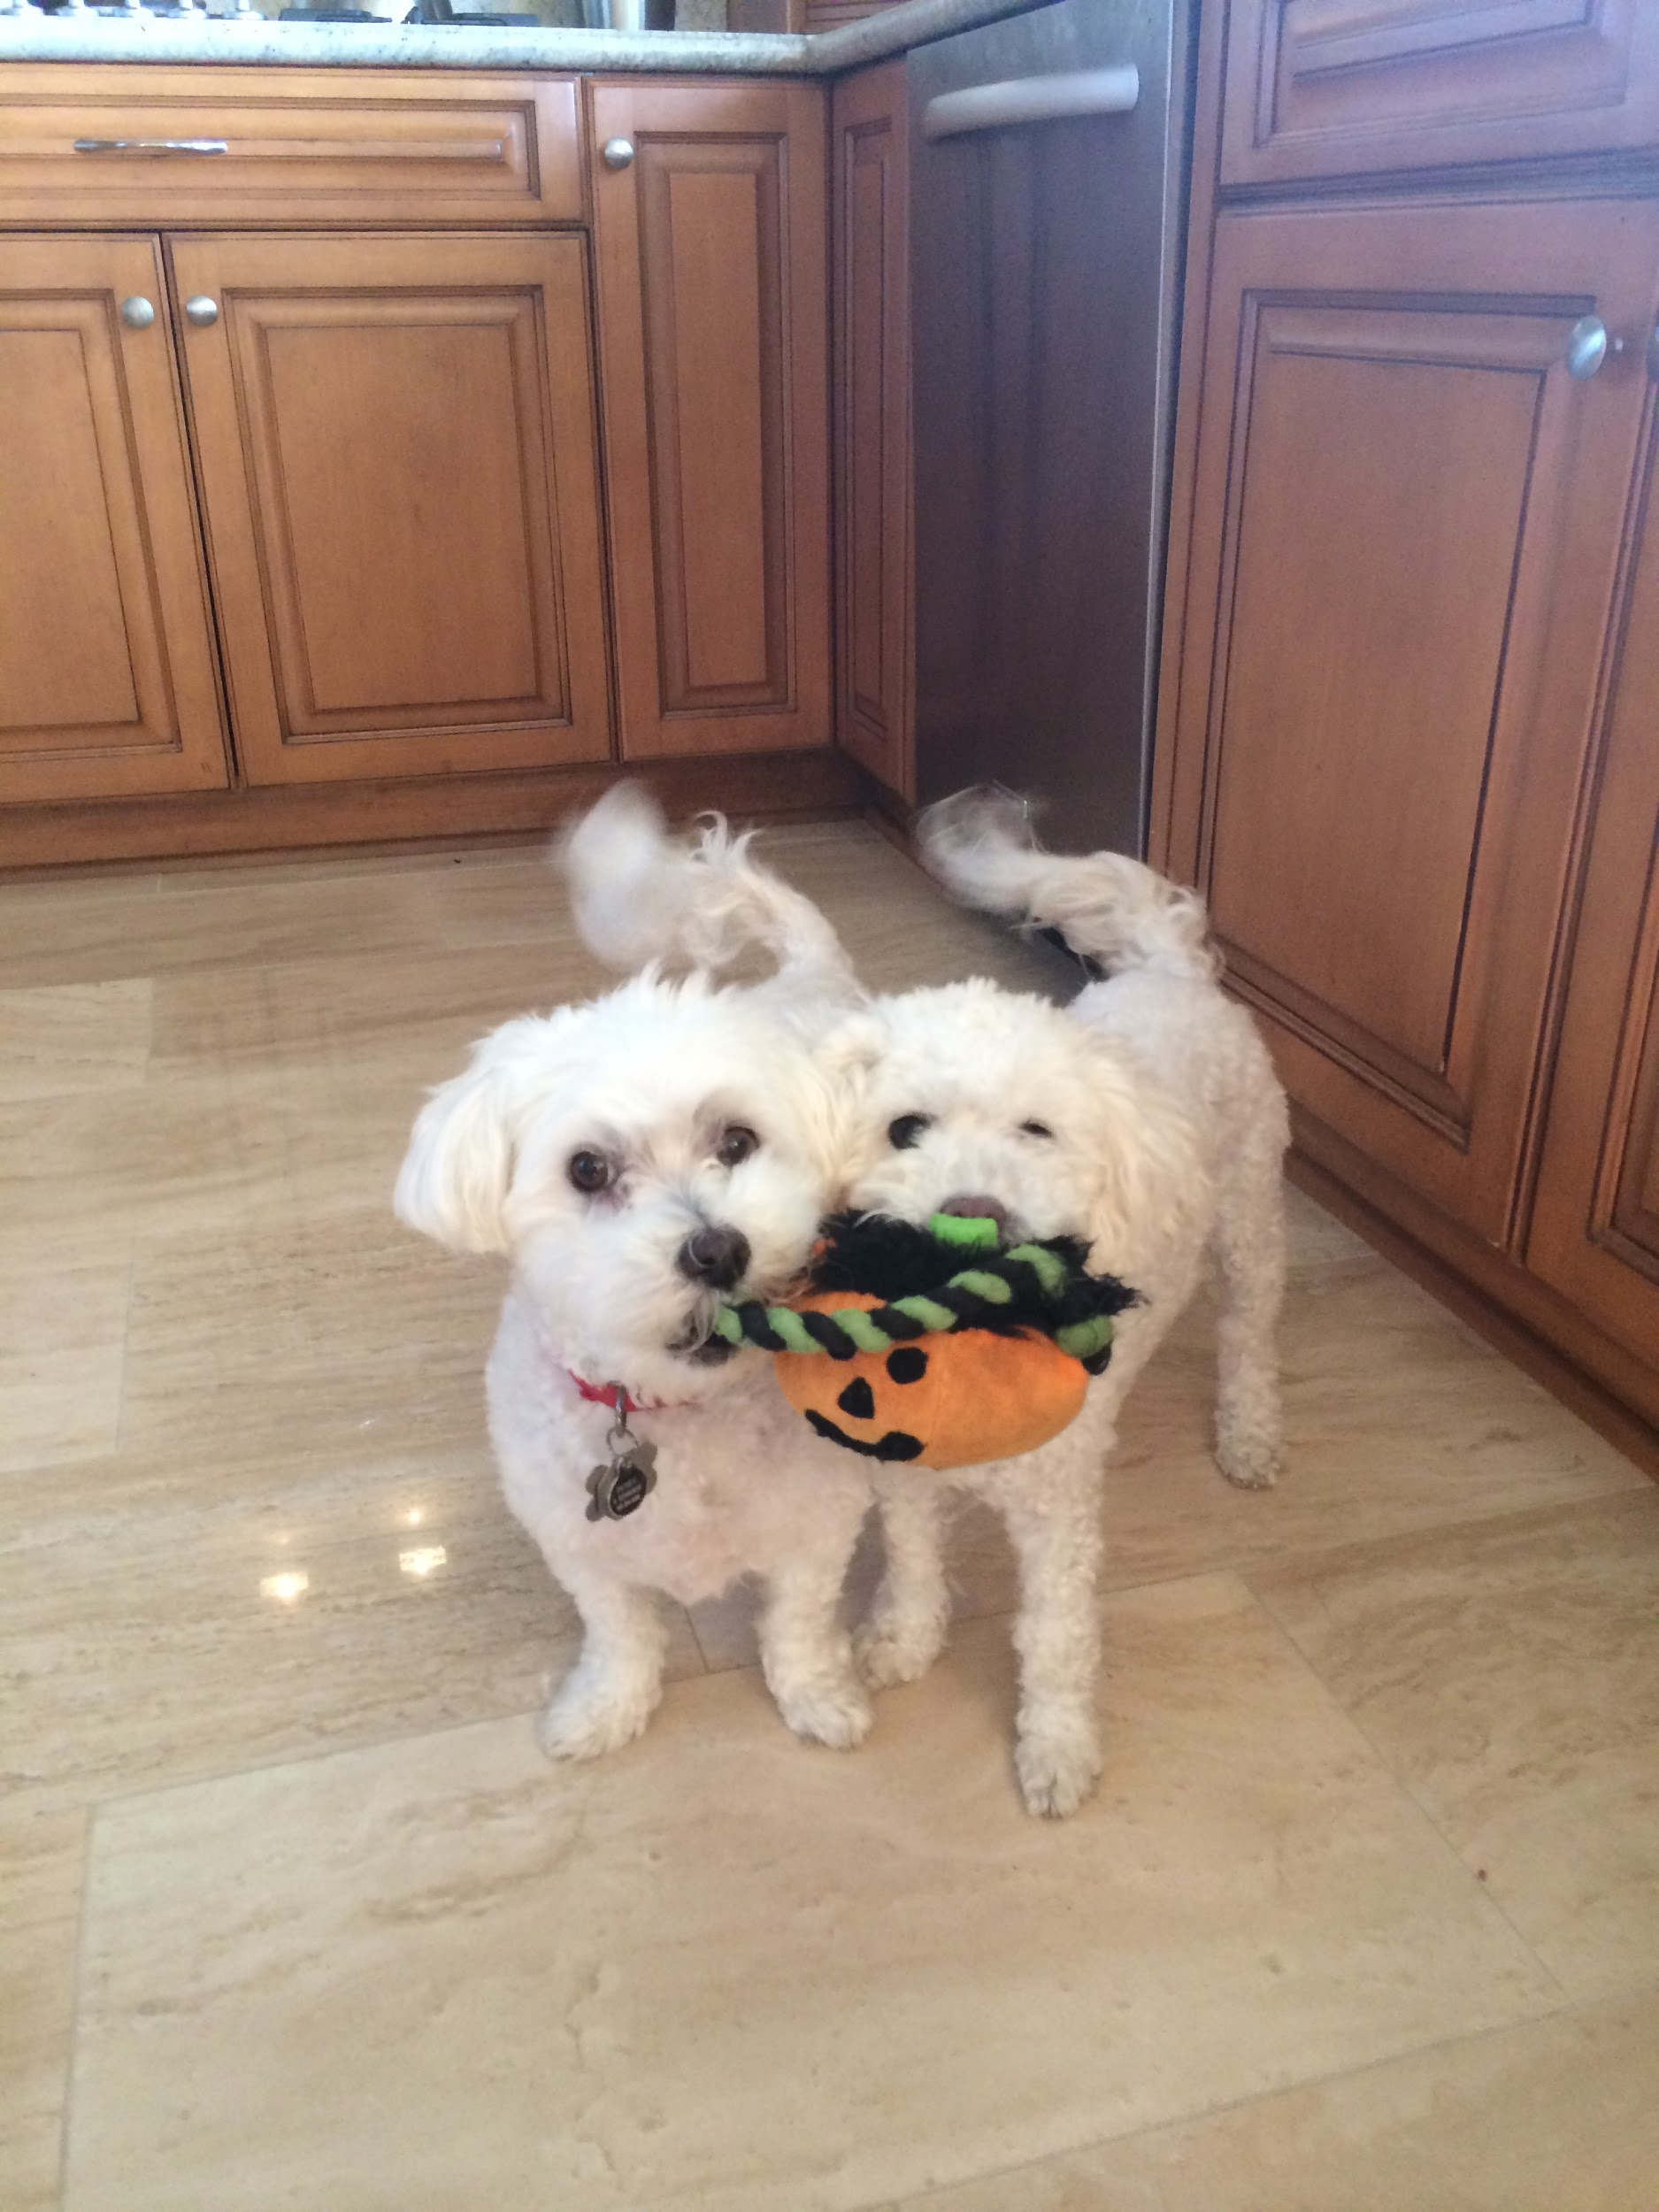
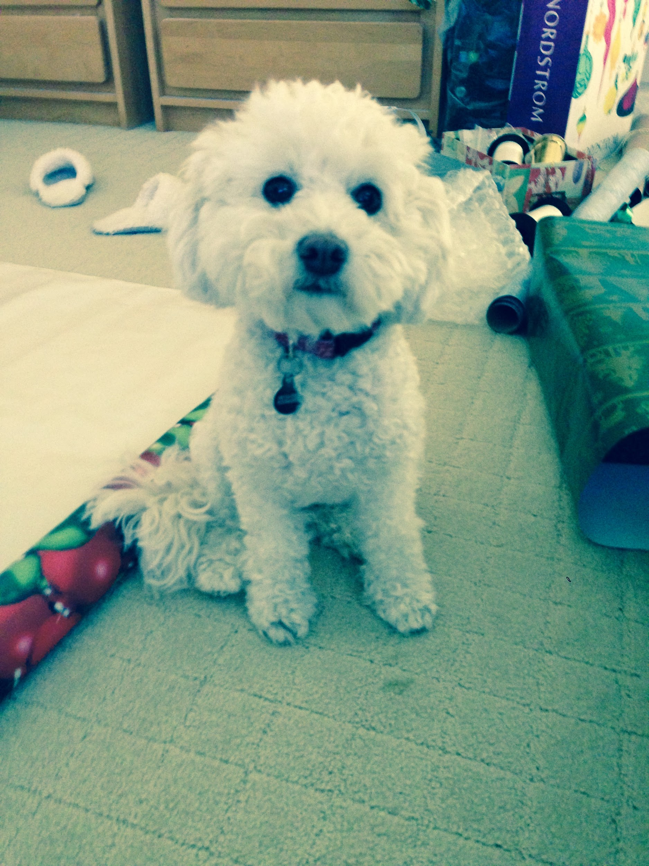

Puppy Playdates
The Problem
Taking care of your dog on a busy schedule
The Solution
A service that matches you to dog owners in your neighborhood based on location and similar goals
Socialization, exercise, dog-sitting, etc.
Free with ads
The Future
Paid membership that gives discounted rates for pet-related services
Extend to different pets

